Slide 1

Spring Boot Fundamentals

Slide 2
Agenda
Introduction to Spring boot
Developing Spring boot REST application
Customizing application properties
Writing Controllers, services
Integrating REST application with DB
Integrating REST application with ORM
Testing application in POSTMAN

Slide 3
What is Spring Boot
Spring – Framework
Boot – BootStrap
Bootstrap spring application from the scratch

Slide 4
What is Spring Boot?
Official definition (spring.io):
Spring Boot makes it easy to create stand-alone, production-grade Spring based applications that you can "just run“
Developed by Pivotal Team
Used to create micro services
Notes:
Anonymous1.java

Slide 5
Problems with Spring
Huge framework
Multiple setup steps (Spring can do many things)
Multiple configuration steps
Multiple build and deploy steps
Handling dependency management is a difficult task when the project grows
Spring boot will abstract out these steps
So that we can focus only on business logic
Notes:
Anonymous1.java

Slide 6
Spring Boot - Characteristics
Stand alone (Just run, no looking for servlet container & configure etc.)
You can develop web application as well as webservices
Production ready
You can get started with minimum configurations without the need for an entire Spring configuration setup.
Supports inbuilt servers such as Tomcat , Jetty
Supports in memory DB- H2 database
Notes:
Anonymous1.java

Slide 7
Spring Boot - Advantages
Easy to understand and develop spring applications
Increases productivity
Reduces the development time
Notes:
Anonymous1.java

Slide 8
Spring Boot – Goals
To avoid complex XML configuration in Spring
To develop a production ready Spring applications in an easier way
To reduce the development time and run the application independently
Offer an easier way of getting started with the application
Notes:
Anonymous1.java

Slide 9
Spring Boot – Set up
- JAVA 8 JDK
- Spring STS (Spring Tool Suite)
- flavor of Eclipse
- tweaked to work with spring boot
- Download from https://spring.io/tools3/sts/all
- Java dependencies:
Use Maven as dependency management tool
Notes:
Anonymous1.java

Slide 10
Creating spring boot application
There are multiple ways:
1. Create a simple maven project, turn it into Spring Boot application
2. Using online Spring Intializr
3. Using Spring Boot CLI with groovy scripts
4. Using Spring Starter Project in STS
Notes:
Anonymous1.java

Slide 11
Spring Initializr
This is another way of creating Spring Boot application
Go to the website: https://start.spring.io/
Fill up some required details
Your spring boot application is ready
Download as .zip file and extract local folder
In STS, import this .pom as maven project
Just run the program
Your application will just run ☺
Just take care of the tomcat port #
Notes:
Anonymous1.java

Slide 12
Spring Boot CLI
This is the command line interface
You can create spring boot application using this
This is not very popular
Just use this for demo purpose
Go to this web site
https://docs.spring.io/spring-boot/docs/current/reference/html/getting-started-installing-spring-boot.html
Download and extract the following file into local folder
spring-boot-cli-2.1.2.RELEASE-bin.zip
Notes:
Anonymous1.java

Slide 13
Using STS IDE Spring Starter Project
Recall bootstrapping from spring initializr (https://start.spring.io)
Select File…New…Spring Starter Project and fill the details
We will be using STS here onwards

Slide 14
Managing Dependencies
In Enterprise applications, we depend on other libraries (.jar files)
Downloading and keeping in the classpath – difficult step, we need to manage such dependencies
For Spring Boot, we will be using MAVEN as dependency management tool

Slide 15
Spring boot starters
Spring Boot provides a number of starters that allow us to add jars in the classpath.
Spring Boot built-in starters make development easier and rapid. Spring Boot Starters are the dependency descriptors.
We have the starters as,

Slide 16
Spring starters
spring-boot-starter | It is used for core starter, including auto-configuration support, logging, and YAML.
spring-boot-starter-web | It is used for building the web application, including RESTful applications using Spring MVC. It uses Tomcat as the default embedded container.
spring-boot-starter-jdbc | It is used for JDBC with the Tomcat JDBC connection pool.
spring-boot-starter-actuator | It is used for Spring Boot's Actuator that provides production-ready features to help you monitor and manage your application.

Slide 17
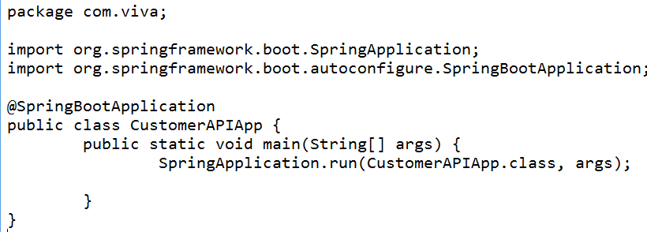
Create a Java class with main method
Name: CustomerAPIApp
Add main() method
This is going to bootstrap the application
Notes:
Anonymous1.java

Slide 18
The magic of annotation
@SpringBootApplication – the class will be treated as spring boot application
@SpringBootApplication annotation can be used to enable those three features, that is:
@EnableAutoConfiguration: enable Spring Boot’s auto-configuration mechanism
@ComponentScan: enable @Component scan on the package where the application is located (see the best practices)
@Configuration: allow to register extra beans in the context or import additional configuration classes

Slide 19
Run the project Java Application
Right click this class
Run as Java application
This is just a dummy project
It has nothing
Let’s add the controller class now
Look at the console:
Notes:
Anonymous1.java

Slide 20
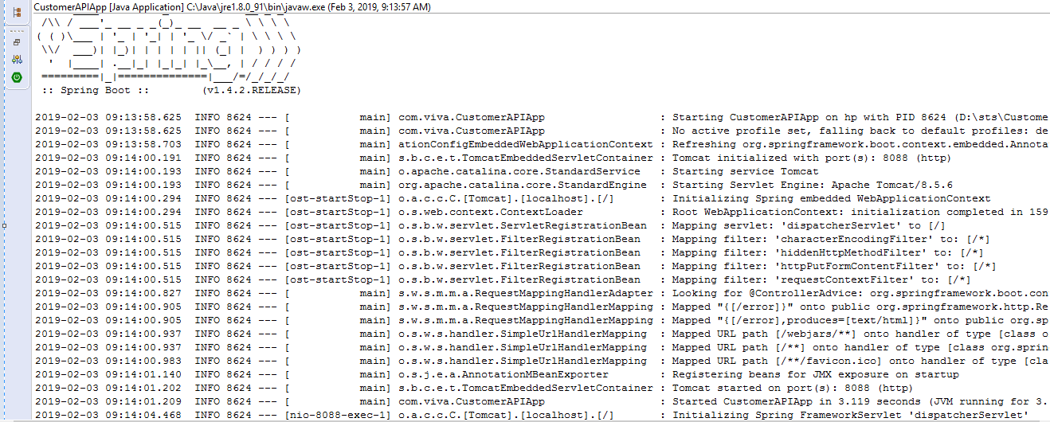
Look at the console
Notes:
Anonymous1.java

Slide 21
Changing the container’s port no
If any other application listens to port number 8080
You would get a failure message
In this case, we need to change the port number of the tomcat container
Just add “application.properties” with the following one line to /src/main/resources folder and restart the application
server.port = 8088
Now, tomcat will be started on port no. 8088
Notes:
Anonymous1.java

Slide 22
Starting Spring Boot The magic line - SpringApplication.run()
1. Sets up default configuration (addresses 80% use cases) – convention over configuration
2. Starts Spring application context (Spring Container)
- Creates a contains - runtime environment
- starts when spring application starts
3. Performs class path scan
- Marking your class with annotation
- Looking at the annotation, it will be creating
component accordingly
4. Starts tomcat server
Notes:
Anonymous1.java

Slide 23
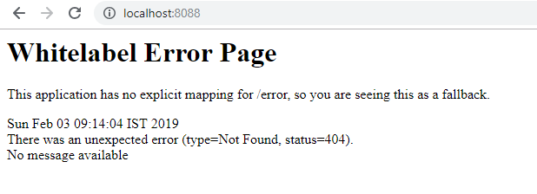
Access the URL
http://localhost:8088/
It would display the error page, since there is no explicit mapping, so you would get a fall back page
Notes:
Anonymous1.java

Slide 24
Why Spring Boot is stand-alone?
Did you add Tomcat container?
All you needed was to just invoke the run method on SpringApplication class
You didn’t need to download any .jar files
Running a web application is just like running a stand-alone Java program from a main method.
Notes:
Anonymous1.java

Slide 25
Add a controller class
Let’s map a URL to a controller class
So, when we access the URL, let’s display some message on the browser
Let’s start with a simple example ←
http://localhost:8080/hi ← URL (‘hi’ is the request)
We should display “Hi to Spring Boot”
Notes:
Anonymous1.java

Slide 26
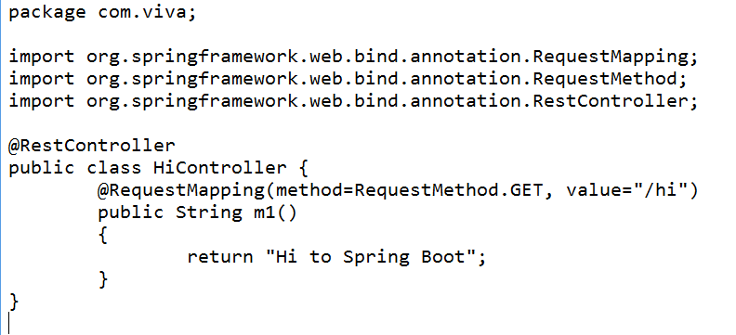
Add Controller class
Controller class is a Java class
It has @RestController annotation at class level
It has @RequestMapping annotation at method level
The web layer in Spring Boot application leverages spring-mvc framework which is a child project of entire spring framework.
Notes:
Anonymous1.java

Slide 27
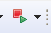
Restart the application
Click the Relaunch icon from STS
Open the browser
Type:
http://localhost:8080/hi
It should print "Hi to Spring Boot"
Notes:
Anonymous1.java

Slide 28
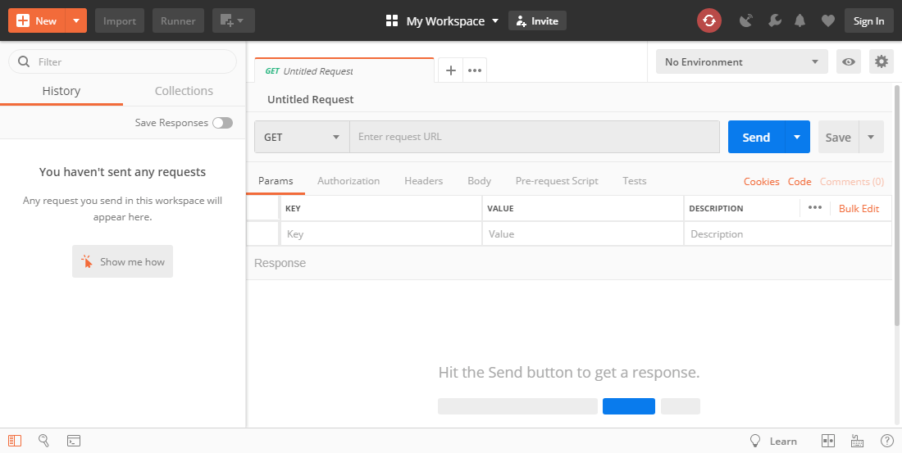
Testing application Using Postman

Slide 29
Case Study – Employee Management System
Imagine, we are going to build REST API using Spring Boot for a Chartered Accountant
The CA maintains different customers’ data
The main entities are:
Employee
Project
Company
Notes:
Anonymous1.java

Slide 30
How to design API?
When designing / developing REST API, you need to think about:
We need to identify the resources:
Resources Deal with NOUNS or ENTITIES
Recall: Employee, Project, Company
In terms of Employees API, Employee is the resource
The consumers can access these resources using different HTTP methods:
GET – for reading
POST – for creating / inserting
DELETE – for removing
PUT – for updating completely
PATCH – for updating partially
Notes:
Anonymous1.java

Slide 31
Designing Customers API
Resources:
Employee
Projects
Company
Notes:
Anonymous1.java

Slide 32
Designing Employees API
GET /employees Gets all employees
GET /employees/id – Gets a employee
POST /employees – Creates a new employee
We need to send the POST BODY
PUT /employees/id – Updates an employee
DELETE /employees/id – Deletes a specific employee
Notes:
Demonsrtate the above mentioned end point and test them from POSTMAN

Slide 33
Returning list objects
Building a REST API:
http://localhost:8088/employees
It should return a list of employees objects
We need a Employee class with properties like firstName, lastName etc
Create some good bunch of employee objects (with values) and add it to Collection List
Return this list from the controller class
Implement this and restart the application
When the URL is fired, it would return an array of JSON objects.
Notes:
Anonymous1.java

Slide 34
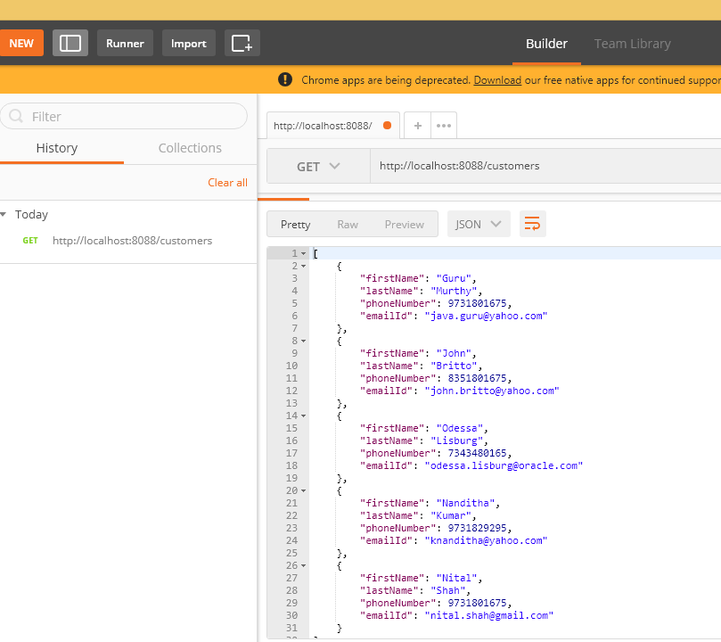
Verify in postman
Notes:
Anonymous1.java

Slide 35
Introducing service classes/layer
In any application, service class / layer is a place where other components seek the services
For instance, the controller ask service class to give a list of customers, give the database connection, open a specific file etc.
In Spring framework, service class is a normal class with @service annotation
Notes:
Service layer will be between Database layer and controller layer to have layered architecture. Add service layer in your project and demonstrate DI, Autowiring etc.

Slide 36
End of Spring Boot Overview

Slide 37
Spring Boot Database Spring JDBC

Slide 38
Spring JDBC with Spring Boot
We need data source
We need to build JdbcTemplate using DS
We will be using methods defined in JdbcTemplate and providing our SQL queries
Spring Boot requires very minimal configuration for this
No need to explicitly define dependencies in Beans.xml
We will be using spring-boot-starter-jdbc

Slide 39
Spring JDBC with Spring Boot
We need data source
We need to build JdbcTemplate using DS
We will be using methods defined in JdbcTemplate and providing our SQL queries
Spring Boot requires very minimal configuration for this
No need to explicitly define dependencies in Beans.xml
We will be using spring-boot-starter-jdbc

Slide 40
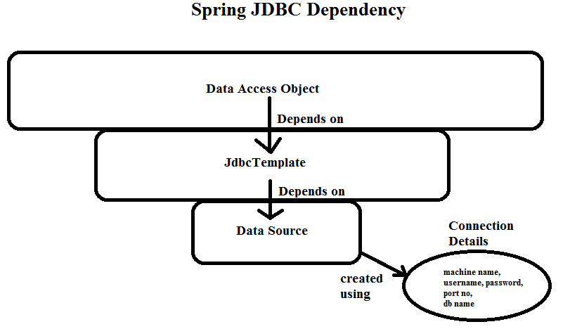
Spring JDBC with Spring Boot

Slide 41
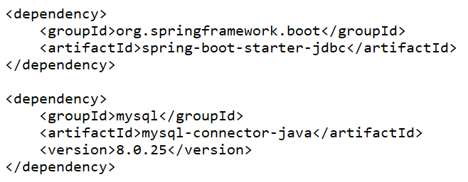
Spring JDBC with Spring Boot
Let’s create a console based application for a change
So, bootstrap Spring application using File…new…Spring Starter Project
Your pom.xml should depend on:

Slide 42
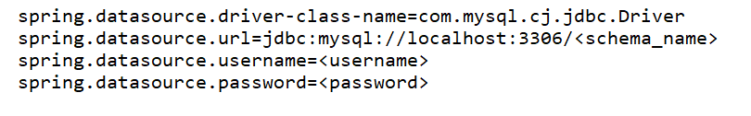
Spring JDBC with Spring Boot
Provide all connection details of MySQL DB in application.properties
#MySQL db settings

Slide 43
Spring JDBC with Spring Boot
Steps
Create table from the entities
Declare the interface for CRUD operations
Provide the implementation for interface
Wire DB layer in Service
Test the code using POSTMAN

Slide 44
Spring Boot Database Spring Data JPA
(with Hibernate)

Slide 45
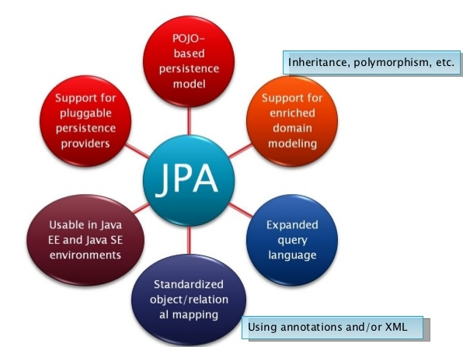
JPA

Slide 46
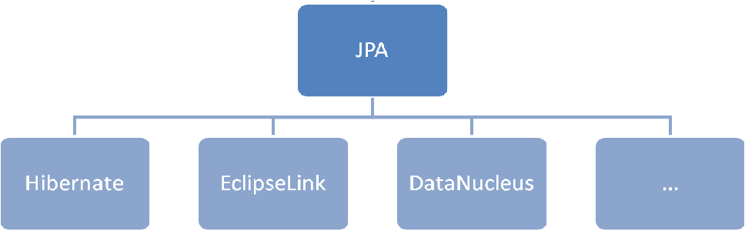
JPA implementation

Slide 47
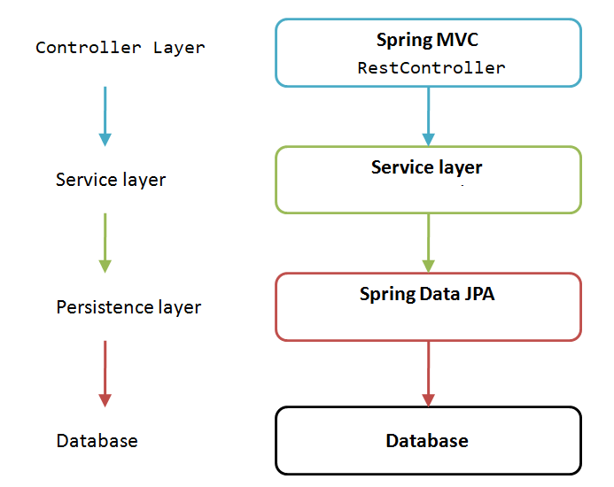
Spring Data JPA

Slide 48
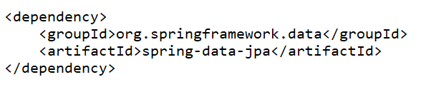
Spring Data JPA
Steps:
Add Spring-data-jpa dependency in pom.xml
2. Configure jpa properties
spring.jpa.show-sql = true
spring.jpa.hibernate.ddl-auto = update
spring.jpa.properties.hibernate.dialect=
org.hibernate.dialect.MySQL8Dialect
Notes:
spring.jpa.hibernate.naming-strategy = org.hibernate.cfg.ImprovedNamingStrategy

Slide 49
3. Add the entity classes
4. Declare JPA repository interfaces
5. Autowire the repository to service
6. Test the application

Slide 50
End of Spring Boot

